Slide 1


Virtualization & Cloud Computing Dr. Robbeloth

Slide 2

What does server mean?

Slide 3
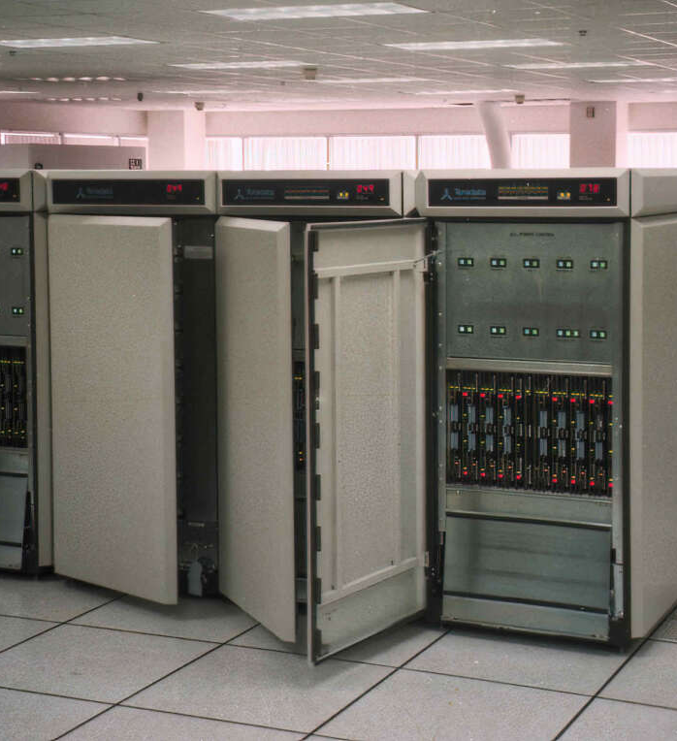
1990s data center in LA Mainframes Teradata 3600s Raspberry Pi 4/5 has more power than one of these today Single application on one server
Notes:
https://visualvoyager.net/visiting-a-data-centre-in-the-1990s/

Slide 4
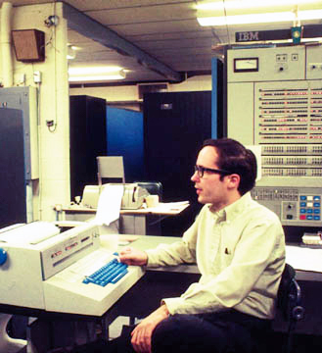
Virtualization is not a new idea It’s been around since the IBM System/360 Model 67 (mid 1960s)

Slide 5
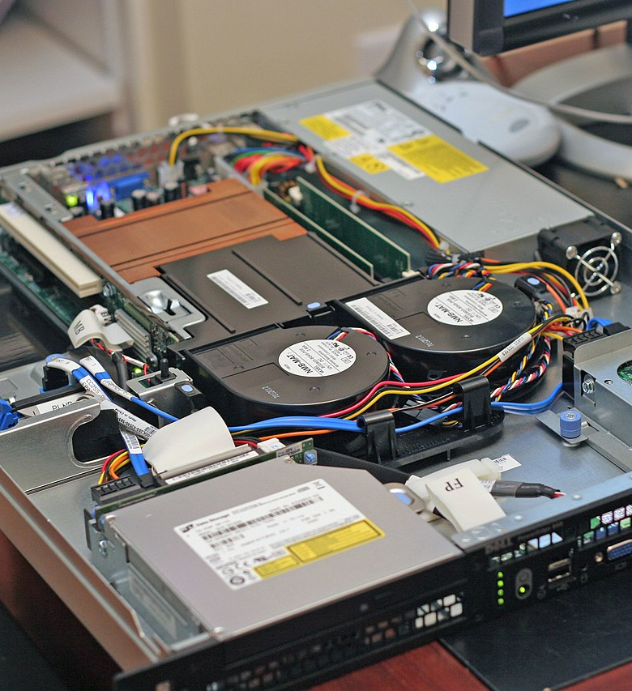
General Changes: They got smaller or more capable at the same size Start to run more than one application Eventually, the OS/service(s) were virtualized into a component you could move around to different hardware boxes– hypervisors were installed on server hardware to allocate resources Lighter weight (e.g., lower CPU/memory/I/O requirements) reproducible entitles specified with configuration files came next – we call them containers

Slide 6
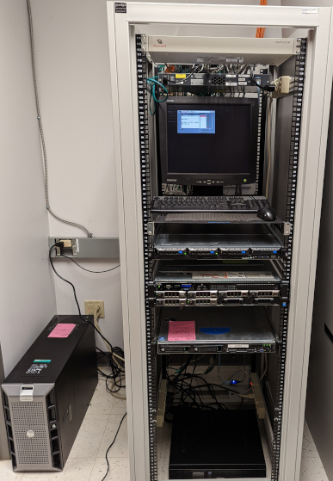
Impact of virtualization on CS: Dynamic allocation Consolidation Scalability/elasticity (variable performance) Availability Rapid prototyping Infrastructure as code (use an API to create a VM) Facilitate CI/CD channels – reduce time to deploy software Permit SaaS/PaaS/IaaS Move servers in part/whole off-premise Backup more easily
Notes:
Dynamic Allocation: Virtualization allows for the dynamic allocation of resources, ensuring that only the necessary resources are used at any given time. This leads to significant cost savings. Consolidation: Multiple physical servers can be consolidated onto a single physical server, reducing hardware costs and maintenance overhead.
Scalability: Cloud computing provides on-
Rapid Prototyping: Virtual environments can be created quickly, facilitating rapid prototyping and experimentation.
Infrastructure as Code (IaC): Cloud computing promotes the use of IaC, allowing infrastructure to be defined and managed using code, enhancing automation and consistency.
Continuous Integration/Continuous Delivery (CI/CD): Virtualization and cloud computing enable efficient CI/CD pipelines, accelerating software delivery and reducing time-to-market.demand scalability, allowing organizations to easily adjust their computing resources based on fluctuating workloads.
Software as a Service (SaaS): Cloud computing has enabled the rise of SaaS models, where software is delivered as a service over the internet, making it more accessible and affordable.
Platform as a Service (PaaS): PaaS platforms provide a ready-to-use environment for developers, simplifying application development and deployment.
Infrastructure as a Service (IaaS): IaaS providers offer on-demand access to computing resources, such as servers, storage, and networking, allowing organizations to focus on their core business.
Allo

Slide 7
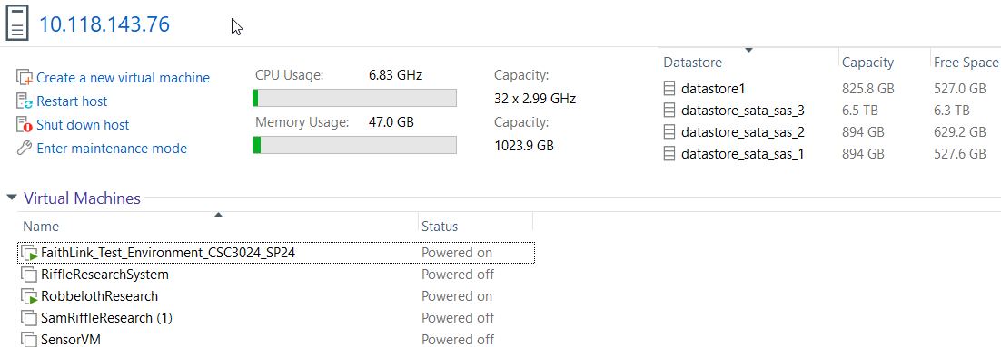
What does that mean to the business world?
Improved operational efficiencies
Automates tasks, reduces costs
Makes it easier to work remotely
Makes the technology more accessible
Improves time to market of products and services
Experiment easier
Lots of VMs/containers on one box reduces energy consumption, slow energy growth
New types of jobs: Cloud architectures, DevOps Engineers, Cloud Security Analysts
Notes:
IT and Technology: These industries have been at the forefront of adopting and developing virtualization and cloud technologies.
Finance: Financial institutions have leveraged cloud computing to improve efficiency, reduce costs, and enhance customer experience.
Healthcare: Cloud-based solutions have helped healthcare organizations improve patient care, streamline administrative processes, and enhance data security.
Retail: Retailers have used cloud computing to improve supply chain management, personalize customer experiences, and enable omnichannel retailing.
Education: Cloud-based learning platforms have made education more accessible and flexible for students and educators

Slide 8
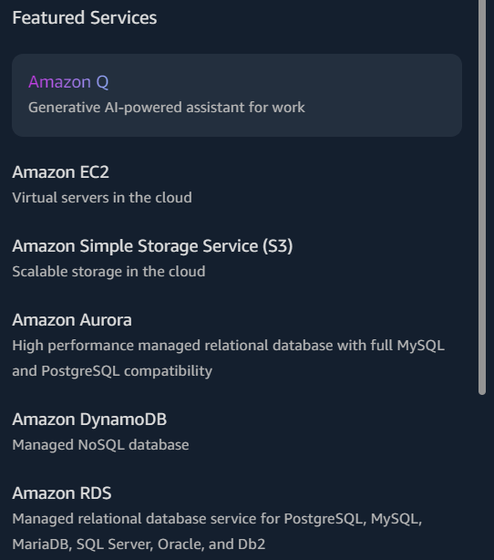
Cloud Computing
Also goes back to the 1960s w/ remote time-sharing systems
Allow multiple users to use system at the same time
1984 – General Magic (network and telecom) coined by David Hoffman
1996 – Compaq biz plan w/ cloud enable computing applications
2002 – Amazon decided to sell excess computing capacity used to support e-commerce site/general operations.
2006 – EC2, S3, Google Docs became available
2010 – Azure, Rackspace, OpenStack (NASA)
2011-2012 – Smartcloud (IBM) and Oracle
2019 – AWS Outposts (AWS to co-location/on-premise)
Notes:
100s of AWS services

Slide 9
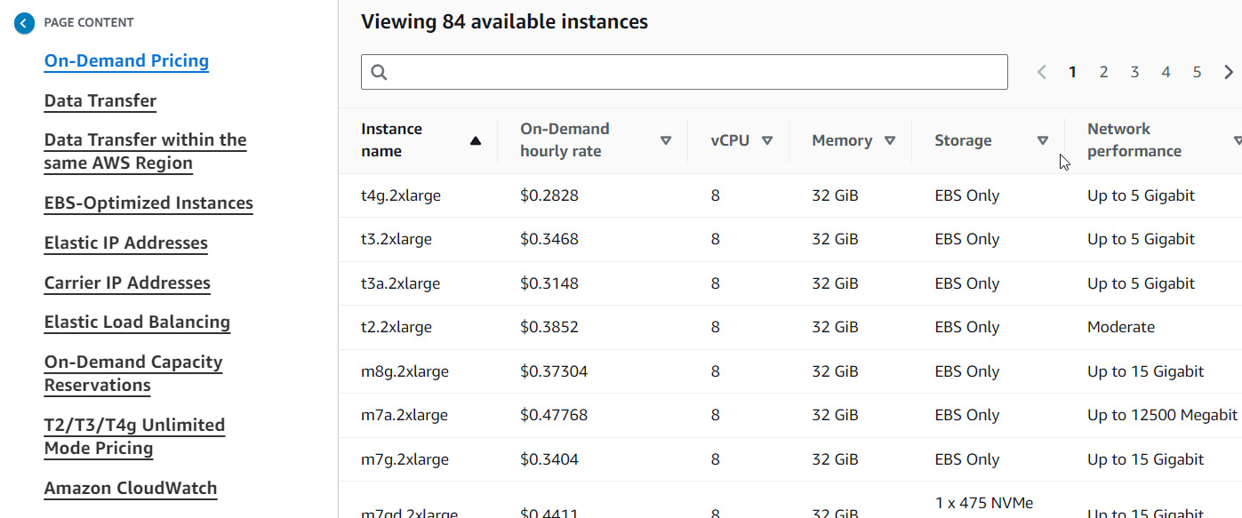
Cloud Computing Cost (You might need an MBA finance degree)
Take one example, EC2 (or VMs)
There is the cost for the instance (on-demand is more expensive than spot or reserved; reserved, you commit to recurring use)
If you want more CPU, GPU, Memory, and/or storage, it will cost. Licensed OS like Windows Server, it will cost more.
There is a cost for IP addresses (especially if you want IPv4, IPv6 costs less, why?)
There is a cost to send data into and out of the system
It’s like a taxi meter running all the time
Notes:
Spot is taking up excess capacity – you take what’s available and don’t throw a fit ☺
Data transferred "in" to and "out" from Amazon EC2, Amazon RDS, Amazon Redshift, Amazon DynamoDB Accelerator (DAX), and Amazon ElastiCache instances, Elastic Network Interfaces or VPC Peering connections across Availability Zones in the same AWS Region is charged at $0.01/GB in each direction.
IPv4: Data transferred "in" to and "out" from public or Elastic IPv4 address is charged at $0.01/GB in each direction.
IPv6: Data transferred "in" to and "out" from an IPv6 address in a different VPC is charged at $0.01/GB in each direction.
For data transferred between a Local Zone and an Availability Zone within the same AWS Region, "in" to and "out" from Amazon EC2 in the Local Zone is charged at the following rate:

Slide 10
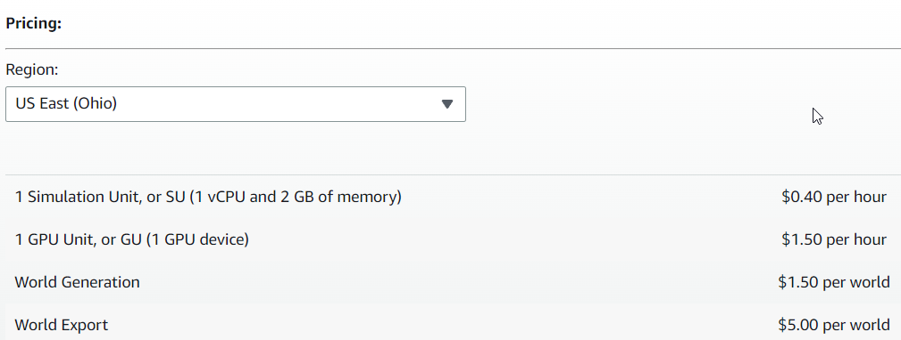
Cloud Computing Cost (A More Exotic Example)
Take another example – AWS RoboMaker Simulation
Robotics Simulation Environment (WorldForge to make world and generate 3D assets, Simulation to run, and export to S3)
Cost in terms of Simulation Units (SUs) – sounds like some in-world game currency
1 vCPU, 2GB memory per SU
Hourly billing
It’s like a taxi meter running all the time
Notes:
Spot is taking up excess capacity – you take what’s available and don’t throw a fit ☺
Data transferred "in" to and "out" from Amazon EC2, Amazon RDS, Amazon Redshift, Amazon DynamoDB Accelerator (DAX), and Amazon ElastiCache instances, Elastic Network Interfaces or VPC Peering connections across Availability Zones in the same AWS Region is charged at $0.01/GB in each direction.
IPv4: Data transferred "in" to and "out" from public or Elastic IPv4 address is charged at $0.01/GB in each direction.
IPv6: Data transferred "in" to and "out" from an IPv6 address in a different VPC is charged at $0.01/GB in each direction.
For data transferred between a Local Zone and an Availability Zone within the same AWS Region, "in" to and "out" from Amazon EC2 in the Local Zone is charged at the following rate:

Slide 11

Thank you
Questions?

